Slide 1
Build Android Apps with the Microsoft Graph
Build native Android Java app using Microsoft Graph Android SDK

Slide 2

Building Microsoft Graph applications
Intro to the Microsoft Graph API
Getting started
Android overview
Creating an Android application for Azure AD & Microsoft Graph

Slide 3
Developer vision
USERS
DATA
HTML
Notes:
Our Office 365 developer vision focuses on the Users’ experience and their data. As a developer you can bring your applications into their user experience. With over 1.2+ billion users of Office Worldwide, this is a huge opportunity to provide a window into your applications. As well as being able to connect into their data and add intelligence to your applications. There are currently 850 million events created a month and a total of 470Pb+ of data stored in the service that can add value to for our Users’.

Slide 4
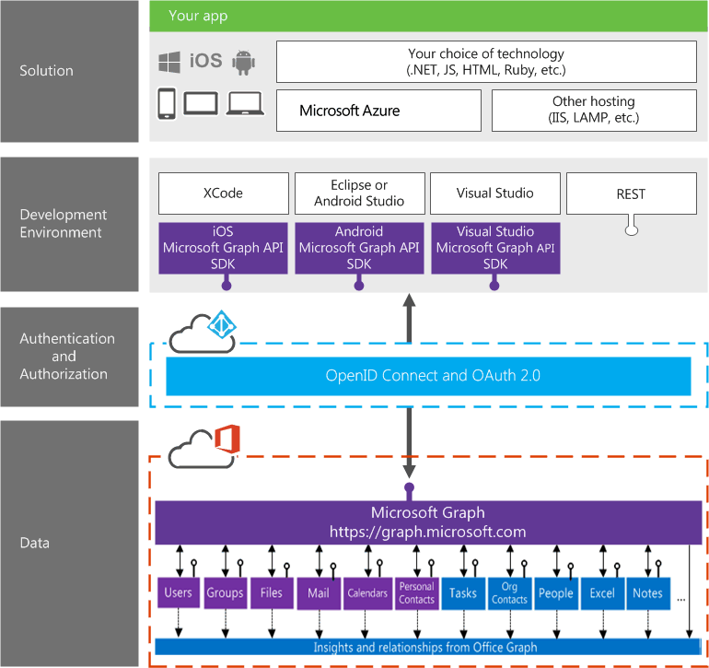
Building integration with Office 365

Slide 5
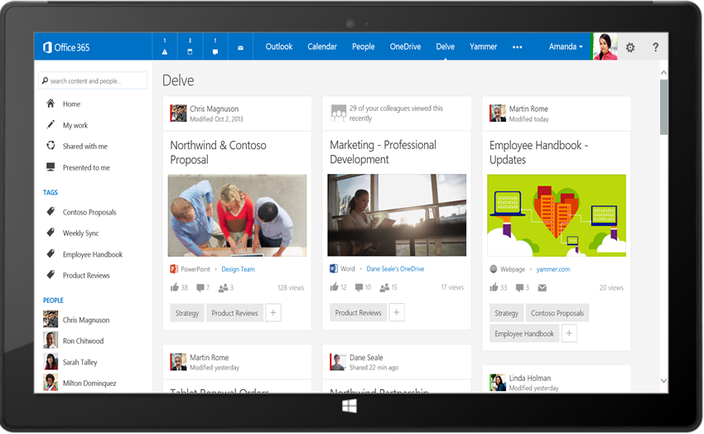
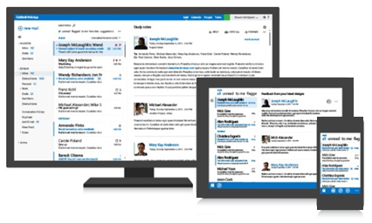
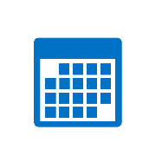

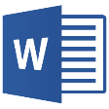
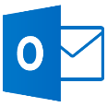
Microsoft Graph API
Your App
https://graph.microsoft.com/
USERS
GROUPS
FILES
MAIL
CALENDAR
TASKS
Insights and relationships from Office Graph

Slide 6
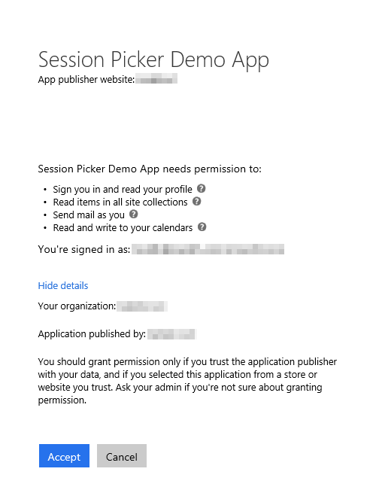
Azure AD OAuth in Office 365
Single authentication flow
Across all Office 365 services
“Native” apps and web sites
Admin and end-user consent
Secure protocol
OAuth 2.0 (no capturing user credentials)
Fine-grained access scopes
Supports MFA and federated user sign-in
Long-term access through refresh tokens
Unique considerations of “Native” Azure Apps
Inherently multi-tenant
No client/app secret (think about distribution)
Leverage a web authentication window/broker
Notes:
The Microsoft Graph leverages Azure AD, like so many other cloud services from Microsoft, for authentication and authorization
You can create web apps as well as native apps with Azure AD apps
In addition, users can authorize the application using delegated consent (where they grant the application to act on their behalf)
Global tenant admins can also grant consent to all users as a different type of consent (Admin Consent)
Azure AD app authentication implemented using OAuth 2.0 protocol
Users are redirected to Azure for authentication so custom applications never get the credentials
Depending on the authentication flow leveraged, the app ultimately gets an access token that’s only valid for a set amount of time, for a specific user, with specific permissions and for a specific resource (ie: Microsoft Graph)
These access tokens can be refreshed after expiration using an associated refresh token
This login process also supports MFA & federated authentication
Native applications differ from web applications in a few ways:
They are multi-tenant by default
You don’t need to worry about app secrets as when the native app is distributed, it can’t contain a secret … because it’s no longer a secret
Instead you use special redirect URIs

Slide 7
Single authentication flow for Office 365
Sign users in using OpenID Connect
Azure AD and Office 365 services
Supports MFA and federated user sign-in
Device apps, web sites, SPAs, and service apps
Pin apps to Office 365 app launcher from My apps
Notes:
All Office 365 cloud services, including SharePoint Online, and Microsoft Graph, leverage Azure AD for authentication and authorization
This means there is a single authentication flow to use Office 365 applications as well as those created to leverage the Microsoft Graph

Slide 8
Android Development Overview
About
Open source Microsoft Graph SDK for Android by Microsoft Open Tech (3/2014)
Available on GitHub (http://bit.ly/1WhLZg4)
Requires ADAL for Android (http://bit.ly/1E7IfSi) / MSAL for Android (https://bit.ly/2xNQB92)
Development
IDE: Android Studio
App registration: Azure Management Portal / App Registration Portal
SDK integration: Gradle for build & package management
When to use
Target device footprint is exclusively Android
Application needs unique device-specific capabilities
Complex/Advanced user experience or visualizations
Notes:
The Microsoft Open Tech group provides a native Android SDK for the Microsoft Graph that is available on GitHub
Developers can leverage either ADAL (for the Azure AD v1 authentication endpoint) or MSAL (for the Azure AD v2 authentication endpoint) in their application depending on the type of application
What’s the development story look like for Android apps?
Developers use the Android Studio, a free IDE implemented on the IntelliJ platform
All application registration is done using one of the two Azure AD management portals
Gradle is a build & package management tool commonly used in Android development
Similar to MSBuild + NuGet in a .NET project
When should you consider doing native Android development?
When you have device specific capabilities
Complex user experience and visualizations
Developers could always use a cross platform option such as Xamarin or Cordova which have their own advantages and disadvantages

Slide 9
Creating an Android native Java application

Slide 10
Process of Creating an Android native application
Create the application using Android Studio
Implement the user experience
Extend the app to support authentication and token acquisition from Azure AD
Integrate the Microsoft Graph Android SDK

Slide 11
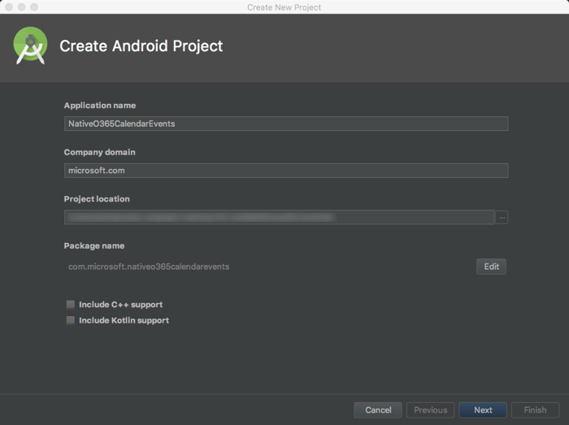
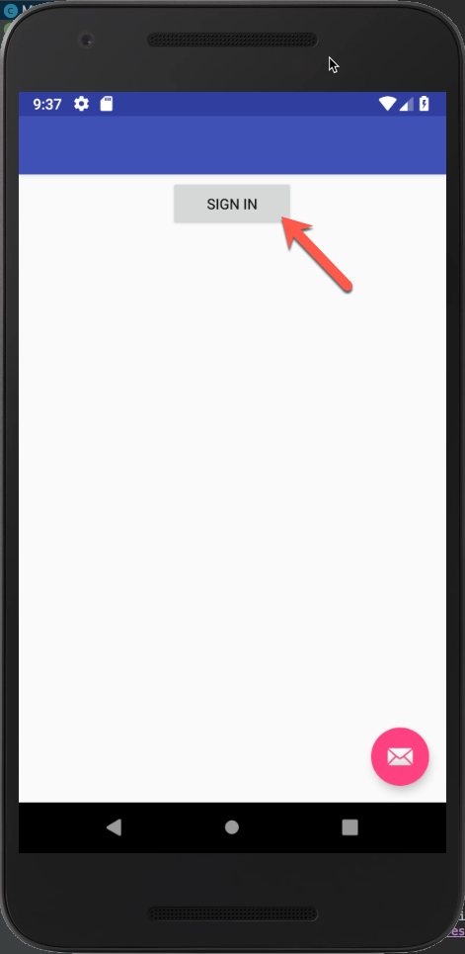
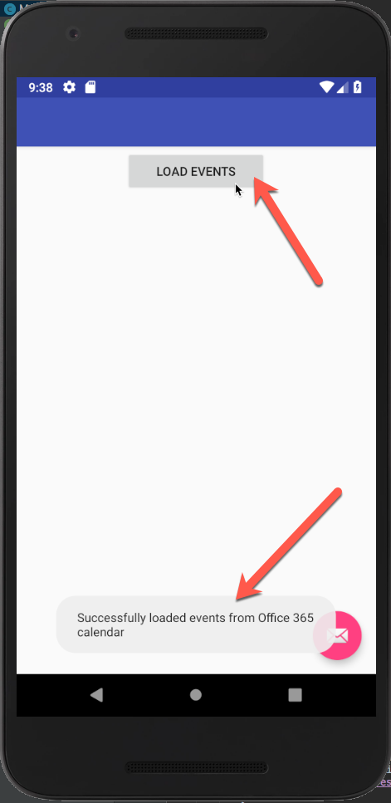
Create Android Native Application
Create the application using Android Studio
Implement User Interface
Test application prior to implementing authentication & integrating Microsoft Graph

Slide 12
Demo

Slide 13
Thank you.

